Slide 1
PNW Wave Energy
Note: much of this slide show is composed of slides utilized from the Wallace Energy Systems and Renewables website (Oregon State University)

Slide 2
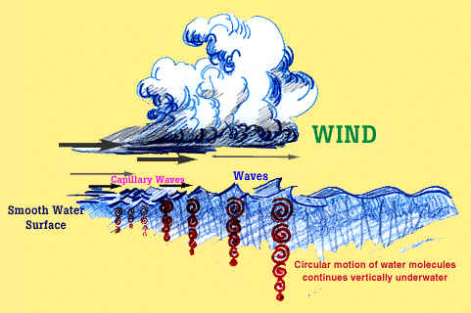
Waves
Waves are a concentrated form of solar energy
Technology to convert wave energy to electrical energy is in its beginning phase
> 1000 Patents
< 2 MW Installed
Demonstration in the U.S. is the Next Needed Step in the Technology Development Process
Notes:
How are waves formed – from the uneven heating of the Earth’s surface by the sun creating winds which when blown over a fetch of ocean, creates waves. The natural processes in the ocean concentrate the solar and wind energy into ocean waves of much greater power density than the original solar and wind energy itself.
The technology to convert waves into electrical energy is in its early phase of development. Based on work in Europe and Australia, the technology is now ready for demonstration and based on the results of this feasibility study, a compelling case to invest in wave energy RD&D has been made. The next step is a feasibility demonstration of the technology in one or more U.S. sites to show
o Its power production performance efficiency
o Its reliability, maintainability and availability
o Its ability to be cost effective
o Its ability to survive storms and operate with a 20 year life

Slide 3
Wave Energy (con’t.)
high energy density, higher energy availability (80-90% of the time)
higher predictability
seasonal cycle is good fit with current PNW supply and demand (has winter max., while natural hydroelectric is winter minimum)
most of US pop. lives <50 miles from coasts

Slide 4
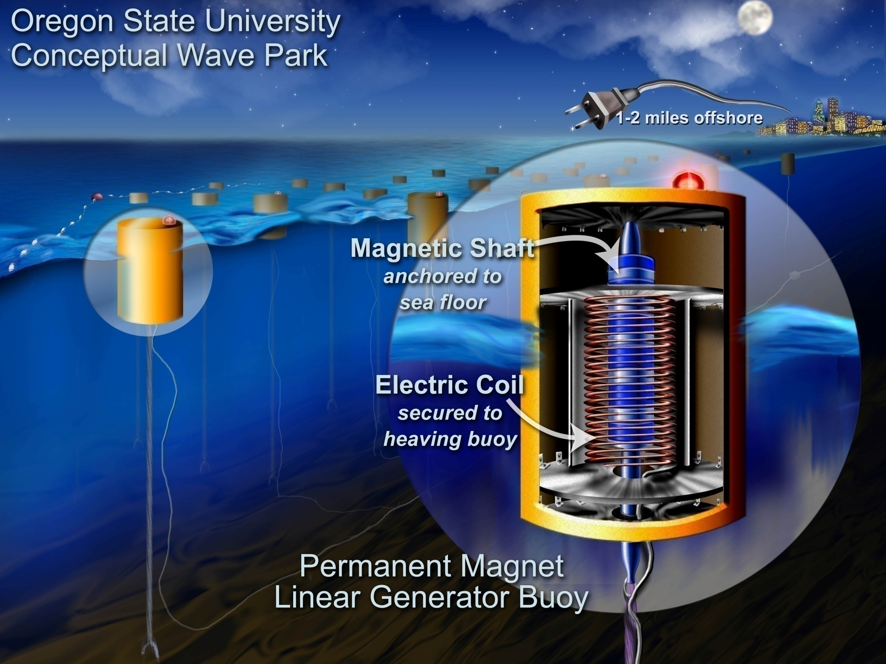

Slide 5
Potential Wave Energy Impact on Oregon
(Load Data Provided by PGE)
Oregon 2005 Avg Consumption Generation
West of Cascades: 3,488MW (68%) 2,487MW (29%) (1001MW deficit)
East of Cascades: 1,633MW (32%) 6,163MW (71%)
Total: 5,121MW 8,650MW
From the previous slide (Winter avg is 50kW/m, Summer avg is 10kW/m), Considering an overall average of 30kW/m and an Oregon coastline of 460km, the total Oregon coast “raw” Wave Energy potential is in the range of 13,800MW
In Perspective
Seven sites have been identified by EPRI study, with the potential to expand to 100MW (estimated that three sites could be fully licensed in next 7-10 years)
Oregon goal for 25% renewables by 2025
(this goal could be 50% satisfied by 700MW from wave energy, based on current consumption)

Slide 6
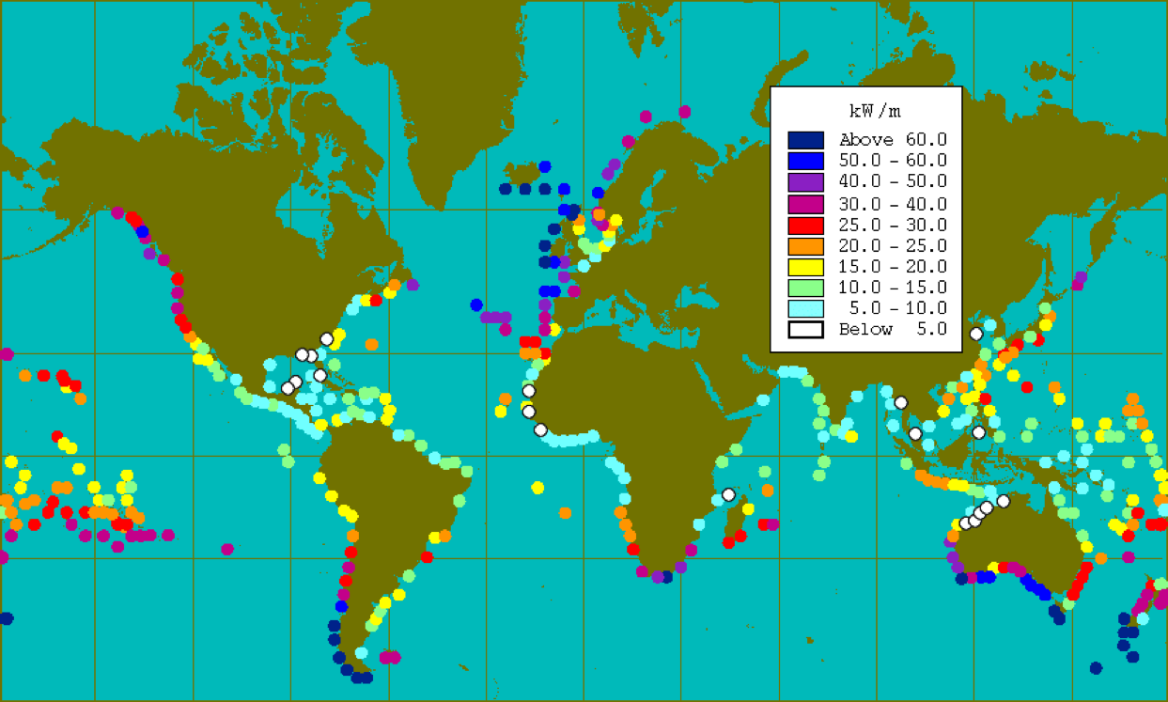
Power From Ocean Waves
Wave energy is strongest on the west coasts and increases toward the poles.
At approx. 30 kW/mcl in the Northwest (yearly avg.), a single meter (3.3 feet) of wave has the raw energy to power about 23 homes.
[George Hagerman]
Notes:
6

Slide 7
Power from Ocean Waves
Available Resource off Oregon Coast
Data buoys are
2-200mi off shore,
with waves
traveling 15-20mph,
gives 10+ hours
forecast time for
buoy generators
located 2 mi out
Seasonal variation –
Good match
for the NW load
demand
(wave data From National Data Buoy Center, Power estimated from
5 buoys off the Oregon coast over past 10 years)
Power from a wave is W/m of crest length (distance along an individual crest)
ρ = the density of sea water = 1025 kg/m³
g = acceleration due to gravity = 9.8 m/s²
T = period of wave (s) (averages 8s in the winter to 6s in the summer)
H = wave height (m) (averages 3.5m in the winter to 1.5m in the summer)

Slide 8
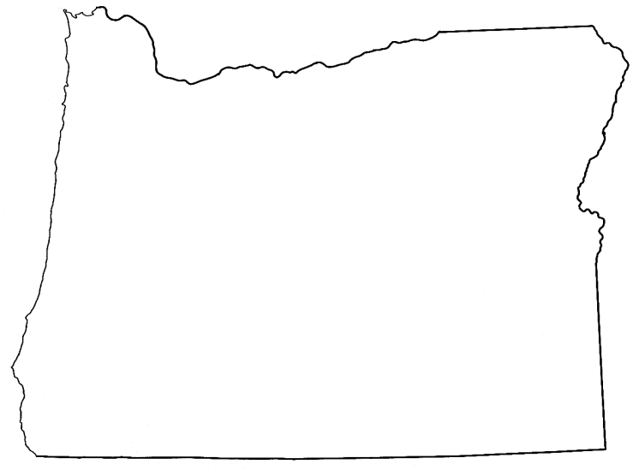
EPRI Study: Seven Oregon Sites
Astoria
Garibaldi
INSERT OREGON MAP
‘Wave Park’
Sites Identified by
EPRI Study
Newport
Cushman
Reedsport
Coos Bay
Brookings

